Slide 1
Gender pre-market (education)

Slide 2
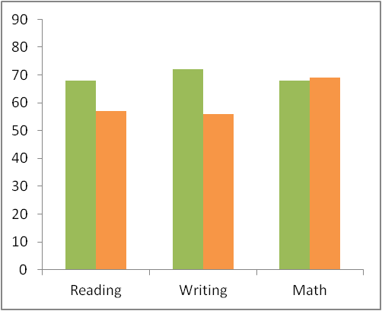
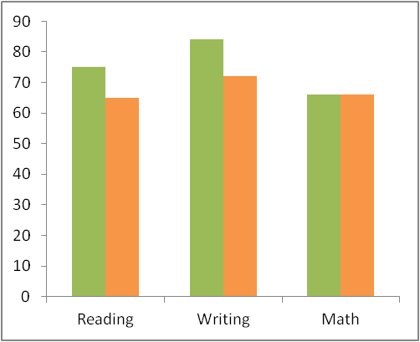
EQAO pass rates(Grade 3)
2005-06
2013-14

Slide 3
K12: Issues
Boys do worse than girls in Ontario on standardised tests
But not true everywhere – math and science scores higher in US (ECLS-K, NELS, eg)
Girls do better on school grades than on standardised tests
But that gap falls/disappears when control for ‘non-cognitive skills’ like in class behaviour, attitudes, repeated grade; homework hours, middle school grades (Jacob; Cornwell, Mustard, Van Parys)

Slide 4
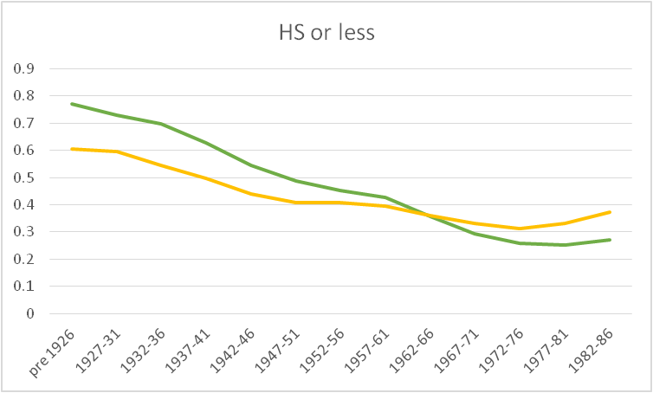
Educational Attainment
NHS data, highest level by age group

Slide 5
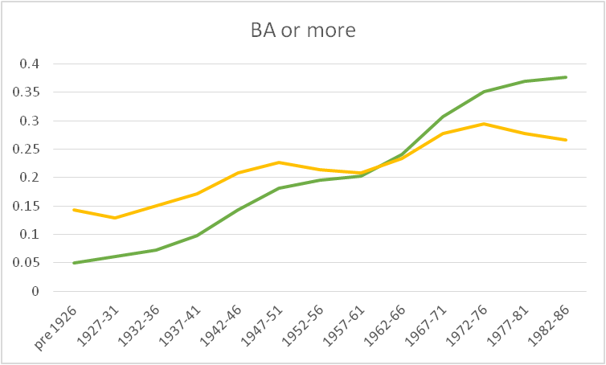
Educational Attainment
NHS data, highest level by age group

Slide 6
Educational Attainment
Overall university enrolments up for women, but not in all fields
Math
Computer science
Economics?
Greater field of study segregation than a few decades ago?

Slide 7
Uni - economics faculty

Slide 8
Non-cognitive skills?
Non-cognitive skills used to explain
Growth in “residual” income inequality
Lower returns to GED than high school grad
Lower college enrolment rates of low income students / from single parent families
Girls’ better performance on school grades conditional on standardised test scores
So if women have better non-cognitive skills than men, and if returns to non-cognitive skills have increased
‘Unexplained’ gender gap should have decreased??

